Slide 1
MALIGNANT COMMENTS CLASSIFICATION
By,
Mohammad Shahid Khan

Slide 2
PROBLEM STATEMENT.
The proliferation of social media enables people to express their opinions widely online.
However, at the same time, this has resulted in the emergence of conflict and hate, making online environments uninviting for users.
Although researchers have found that hate is a problem across multiple platforms, there is a lack of models for online hate detection.
Online hate, described as abusive language, aggression, cyberbullying, hatefulness and many others has been identified as a major threat on online social media platforms. Social media platforms are the most prominent grounds for such toxic behaviour.
There has been a remarkable increase in the cases of cyberbullying and trolls on various social media platforms.
While online anonymity has provided a new outlet for aggression and hate speech, machine learning can be used to fight it.
Our goal is to build a prototype of online hate and abuse comment classifier which can used to classify hate and offensive comments so that it can be controlled and restricted from spreading hatred and cyberbullying.

Slide 3
Dataset
The data set contains the training set, which has approximately 1,59,000 samples and the test set which contains nearly 1,53,000 samples.
All the data samples contain 8 fields which includes ‘Id’, ‘Comments’, ‘Malignant’, ‘Highly malignant’, ‘Rude’, ‘Threat’, ‘Abuse’ and ‘Loathe’.
The label can be either 0 or 1, where 0 denotes a NO while 1 denotes a YES.
There are various comments which have multiple labels.
The first attribute is a unique ID associated with each comment.

Slide 4
EDA
1.Understanding of the data
2.Checking the missing values
3.Checking for numerical columns
4.Checking for the distribution of numerical variables
5.Checking for Categorical variables
6.Types of categorical variables
7.Detecting outliers

Slide 5
Understanding of the data
Malignant: It is the Label column, which includes values 0 and 1, denoting if the comment is malignant or not.
Highly Malignant: It denotes comments that are highly malignant and hurtful.
Rude: It denotes comments that are very rude and offensive.
Threat: It contains indication of the comments that are giving any threat to someone.
Abuse: It is for comments that are abusive in nature.
Loathe: It describes the comments which are hateful and loathing in nature.

Slide 6
ID: It includes unique Ids associated with each comment text given.
Comment text: This column contains the comments extracted from various social media platforms. This project is more about exploration, feature engineering and classification that can be done on this data. Since the data set is huge and includes many categories of comments, we can do good amount of data exploration and derive some interesting features using the comments text column available.
We need to build a model that can differentiate between comments and its categories.

Slide 7

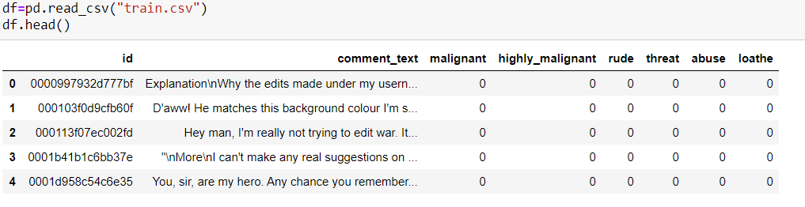
Importing libraries and the dataset
Imported necessary libraries which is required for the project.
Imported training dataset required for analysis.

Slide 8
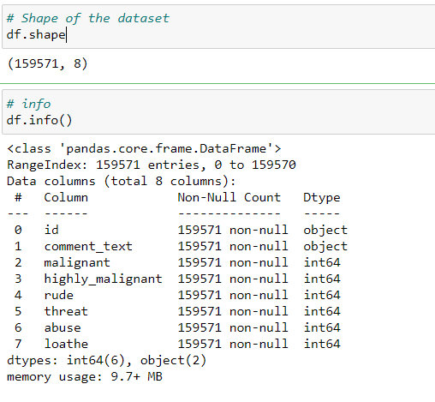
Knowing Info. of the dataset.
df.shape() describes the total rows and columns available in the dataset.
There are 159571 rows and 8 columns present in the dataset.
Df.info() provides information about the data types.
The data info says that there are 6 integer columns and 2 categorical columns.

Slide 9
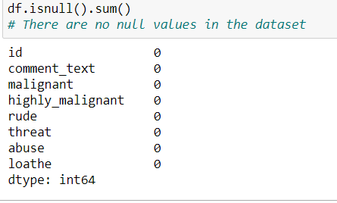
Checking the missing values
df.isnull().sum() Shows the presence of missing values in the data set.
There were no missing values present in the dataset.

Slide 10
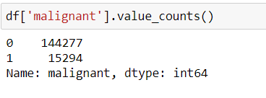
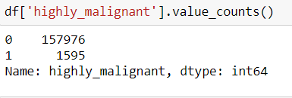
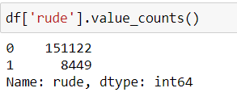
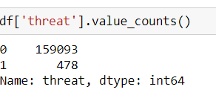
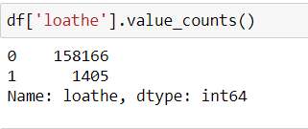
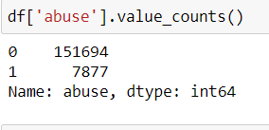
Checking for numerical columns and their distribution.
There are only 2 unique values in all the columns.
Hence the columns are not the continuous data.
The data is ordinal type of categorical data.
Hence no outliers can be found in the dataset.

Slide 11
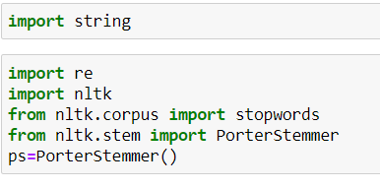
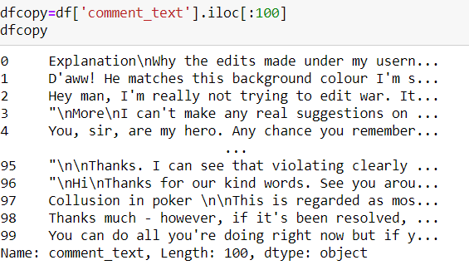
Data cleaning and Importing nlp libraries.
The above are the necessary libraries which is required for text cleaning.

Slide 12
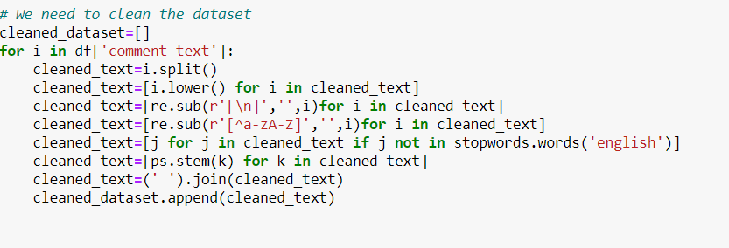
The above is the code to extract only text from the dataset by eluminating all the extra special characters, numerical. By creating the empty list and appending the cleaned data into it.

Slide 13
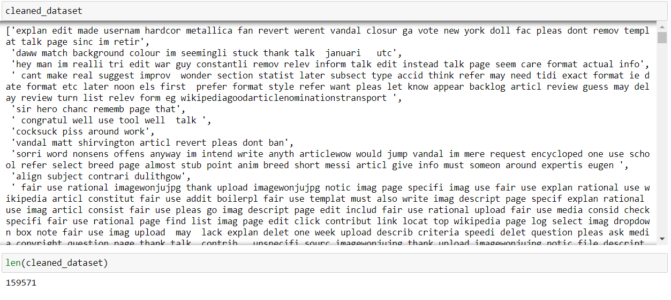
The column which is resulted after cleaning.

Slide 14
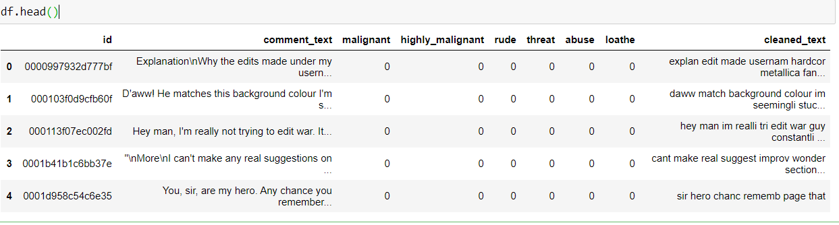
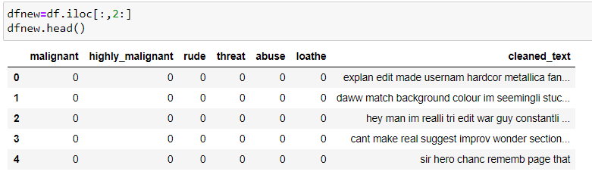
The dataset view
Dataset with new column.

Slide 15
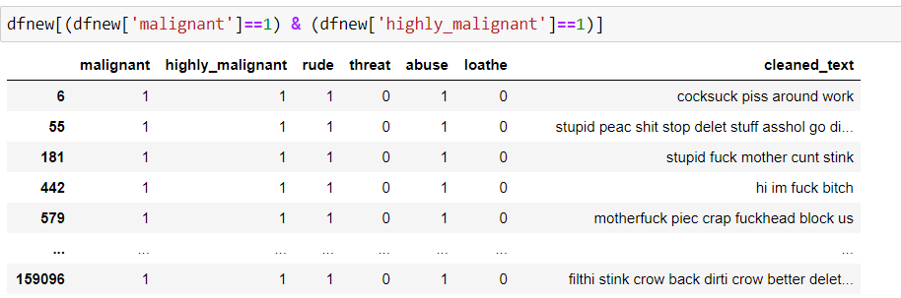
Columns with multi-labels.
Text which is malignant and highly malignant.
1595 rows has both tags.

Slide 16
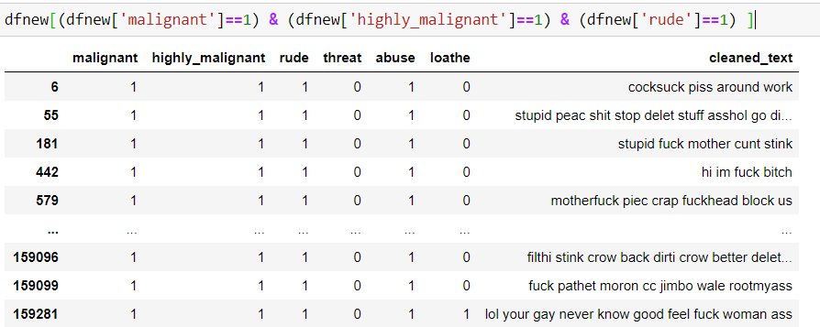
Text which is malignant , highly malignant and rude.
1517 rows has all the tags.

Slide 17
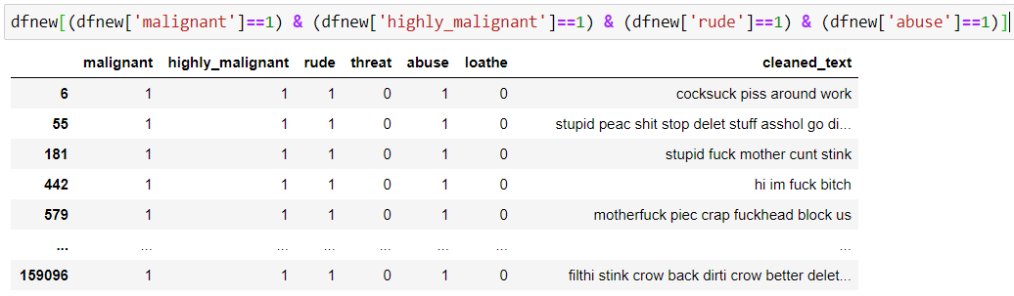
Text which is malignant , highly malignant , rude and abuse.
1349 rows has all the tags.

Slide 18
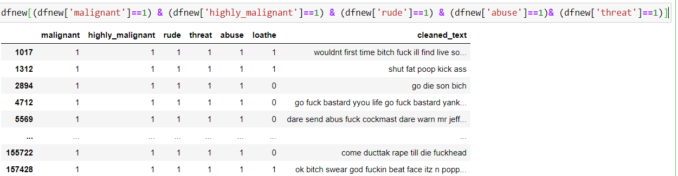
Text which is malignant , highly malignant , rude , abuse and threat.
95 rows has all the tags.

Slide 19
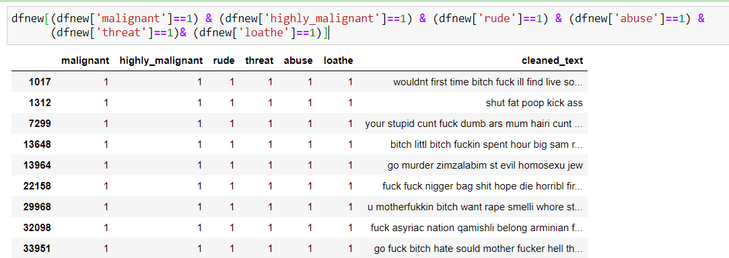
Text which is malignant , highly malignant , rude , abuse , threat and loathe.
31 rows has all the tags.

Slide 20
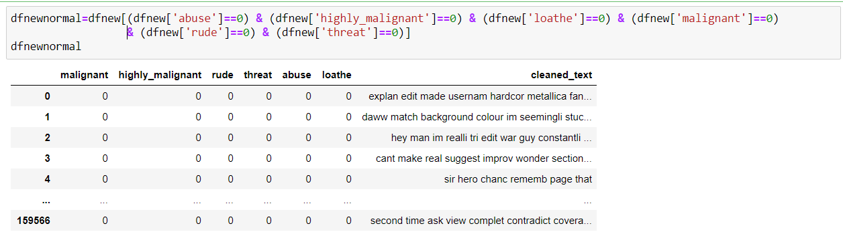
Normal rows with negative comments.
Totally 143346 rows.

Slide 21
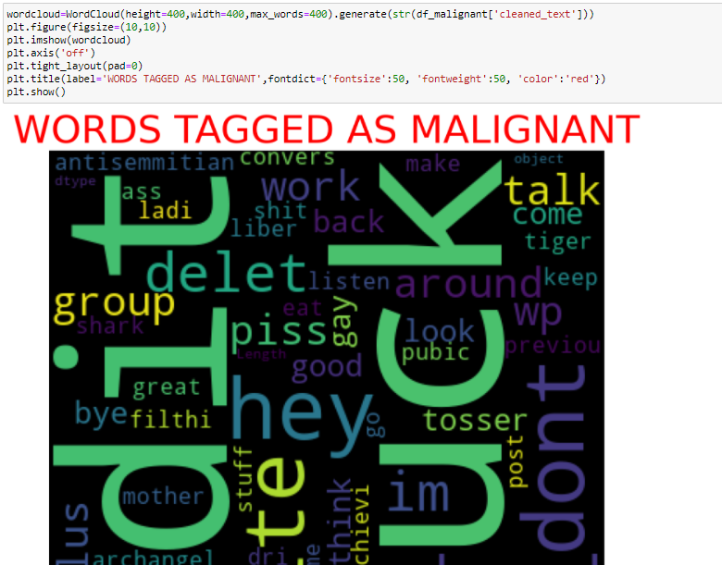
Wordcloud for each label separately
Wordcloud for Malignant.

Slide 22
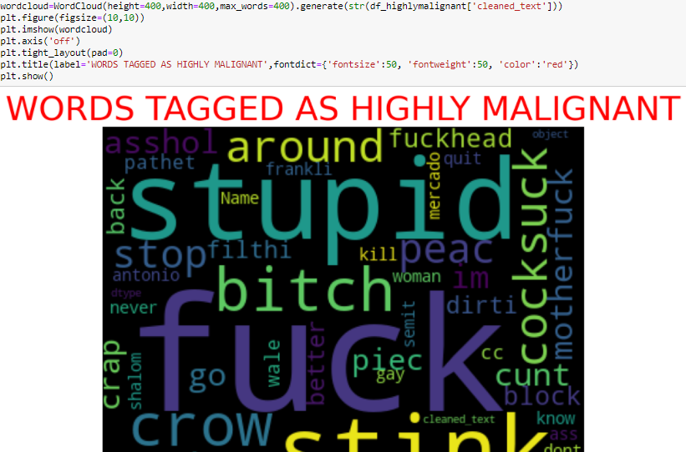
Wordcloud for Highly Malignant.

Slide 23
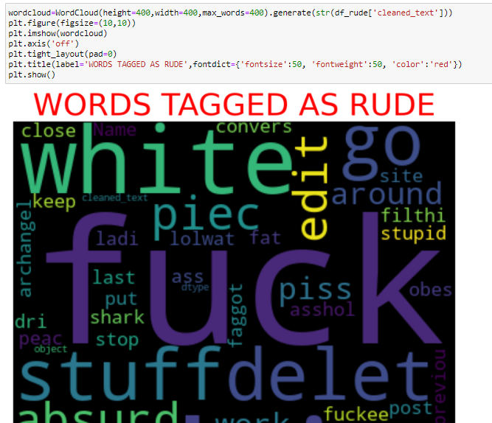
Wordcloud for Rude.

Slide 24
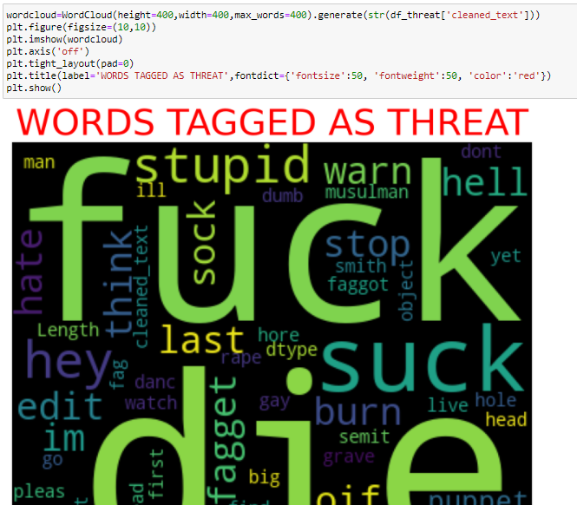
Wordcloud for Threat.

Slide 25
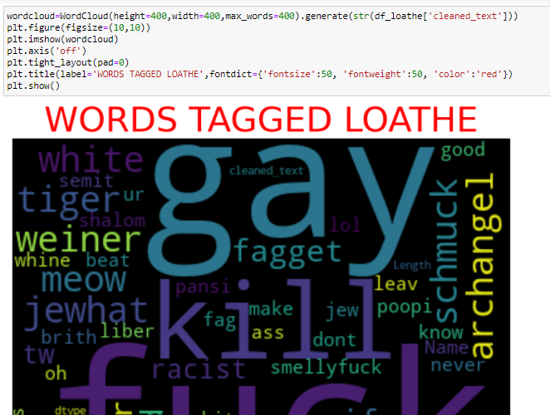
wordcloud for loathe.

Slide 26
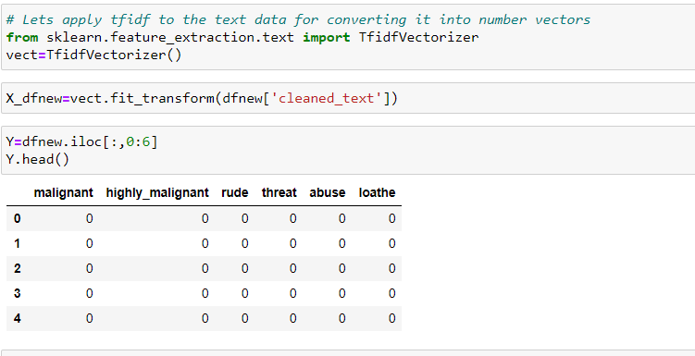
Vectorization
After cleaning the text data, the text data was converted to numerical vector for the further analysis.
The dependent and independent data was separately labelled.

Slide 27
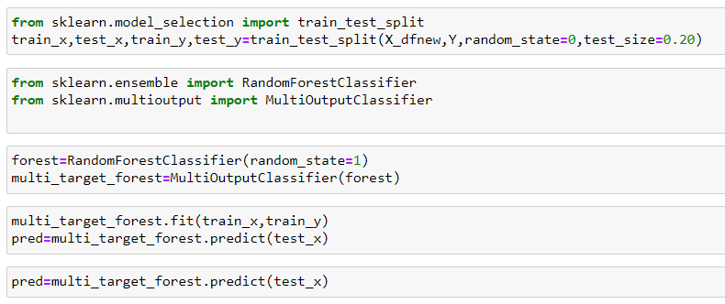
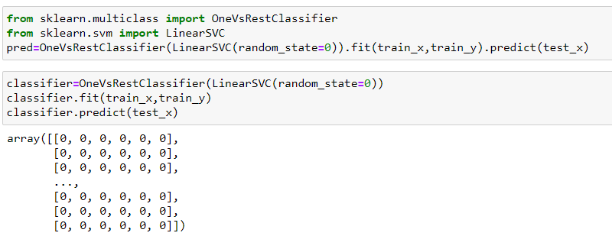
The data was splitted into train and test for training and valiadation.
The Random forest and SVC were the two models used for modelling.
The model which was performed better was later used for prediction.

Slide 28
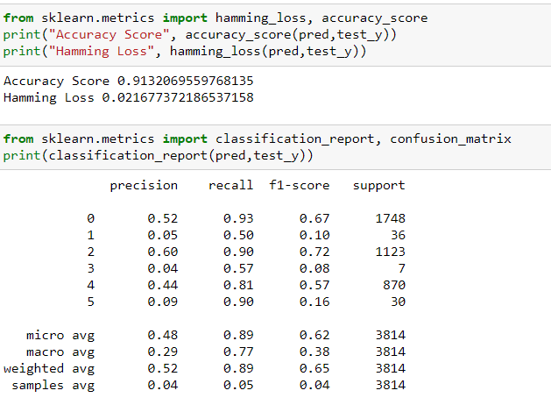
The accuracy score for Random forest model was found to be 91.3 per cent and the loss was 2 per cent.

Slide 29
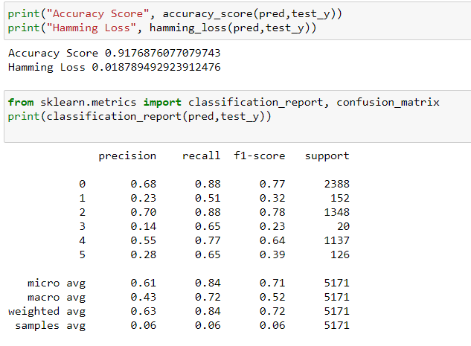
The accuracy score for Random forest model was found to be 91.7 per cent and the loss was 1.8 per cent.
From both the model we can conclude that the SVC model is performing better when compare to Random
forest model. Hence can be used for predicting the unseen data.

Slide 30
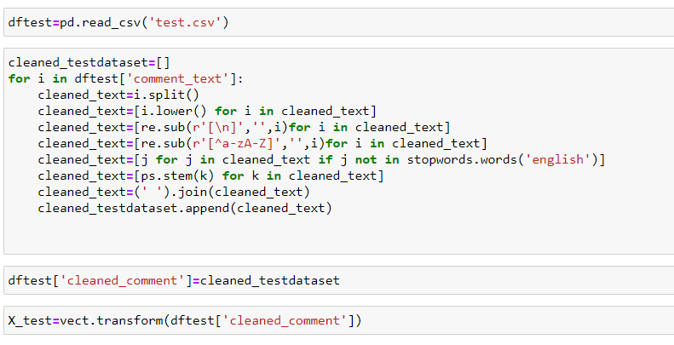
Test data for prediction.
Imported test data for prediction.
The same EDA was carried out for the test data which was followed for train data.

Slide 31
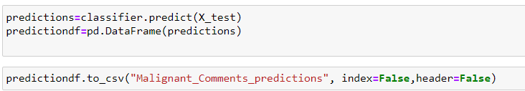
Predictions was converted into data frame and was stored in CSV file.

